Slide 1
Do you like going to the cinema?

Slide 2
Yes, I do.
No, I do not.

Slide 3
What is the last film you have seen?

Slide 4
The last film I have seen is…

Slide 5
Where does it take place?

Slide 6
It takes place in the cinema.

Slide 7
What are these people doing?

Slide 8
They are watching a film (a movie).

Slide 9
And what are these people doing?

Slide 10
They are buying tickets.

Slide 11
Topic for today
Buying tickets at the cinema

Slide 12
Task 1 Remember genres of films

Slide 13
Combine the genre of the film with the translation

Slide 14
Check yourself
A thriller – триллер
A historical film – исторический фильм
A fantasy – фантастика
A horror film – фильм ужасов
A western – вестерн
A comedy – комедия
A love story – фильм о любви
A documentary – документальный фильм

Slide 15
Task 2
Make up movie genres out of words
1. A afsnayt
2. A ocmdey
3. A wtenser
4. A odmcntreauy

Slide 16
Check yourself
1. A fantasy – фантастика
2. A comedy – комедия
3. A western – вестерн
4. A documentary – документальный фильм

Slide 17
Task 3
Guess the genre of the film from the description

Slide 18
A thriller

Slide 19
A comedy

Slide 20
An adventure

Slide 21
A love story

Slide 22
An animation

Slide 24
Task 4
Find as many words related to the topic «Cinema»
tickets, comedy, powerful voice, role, singer, acting, catchy tunes, latest album, movie, plot, cast, popular single, science fiction, film, fantasy

Slide 25
Check yourself
tickets, comedy, powerful voice, role, singer, acting, catchy tunes, latest album, movie, plot, cast, popular single, science fiction, film, fantasy

Slide 26
Some new words and phrases
the showing – сеанс
your change –ваша сдача
discount for students – скидка для учеников
Enjoy the movie – наслаждайся фильмом
Next, please! – Следующий, пожалуйста!
It is sold out. –Продано.

Slide 27
Listen the dialogue 1
Ticket seller: Next, please.
Andy: One adult and one child for Harry Potter, please.
Ticket seller: Is that for the 7 pm or the 10 pm showing?
Andy: 7 pm, please.
Ticket seller: That is £ 12 altogether, then.
Andy: Here you are.
Ticket seller: Thank you. Here are your tickets and your change.
Andy: Thanks.

Slide 28
Listen the dialogue 2
Jane: Two tickets for King Kong at 6 pm, please.
Ticket seller: I am afraid it is sold out.
Jane: Oh, right.
Ticket seller: We still have tickets for the 9 pm and the 11.30 pm showing.
Jane: Oh, OK. Two tickets for 9 pm then, please.
Ticket seller: That is £ 14, please.
Jane: Is there a discount for students?
Ticket seller: Yes. Tickets are £ 5 for students.
Jane: Here you are.
Ticket seller: Thank you. Enjoy the movie!

Slide 29
Schedule at the cinema
Robin Good 9:30 pm
The Sixth Sense 2 pm
The Matrix 10:30 pm

Slide 30
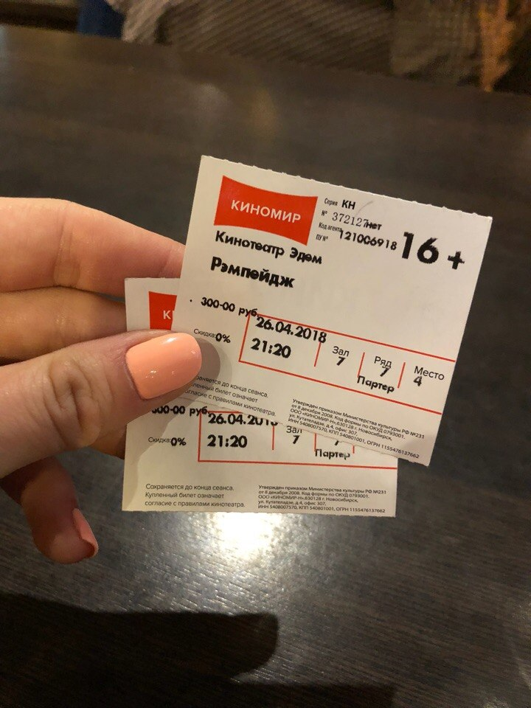
Сan you buy movie tickets?

Slide 31
Thank you for your work

