Slide 1
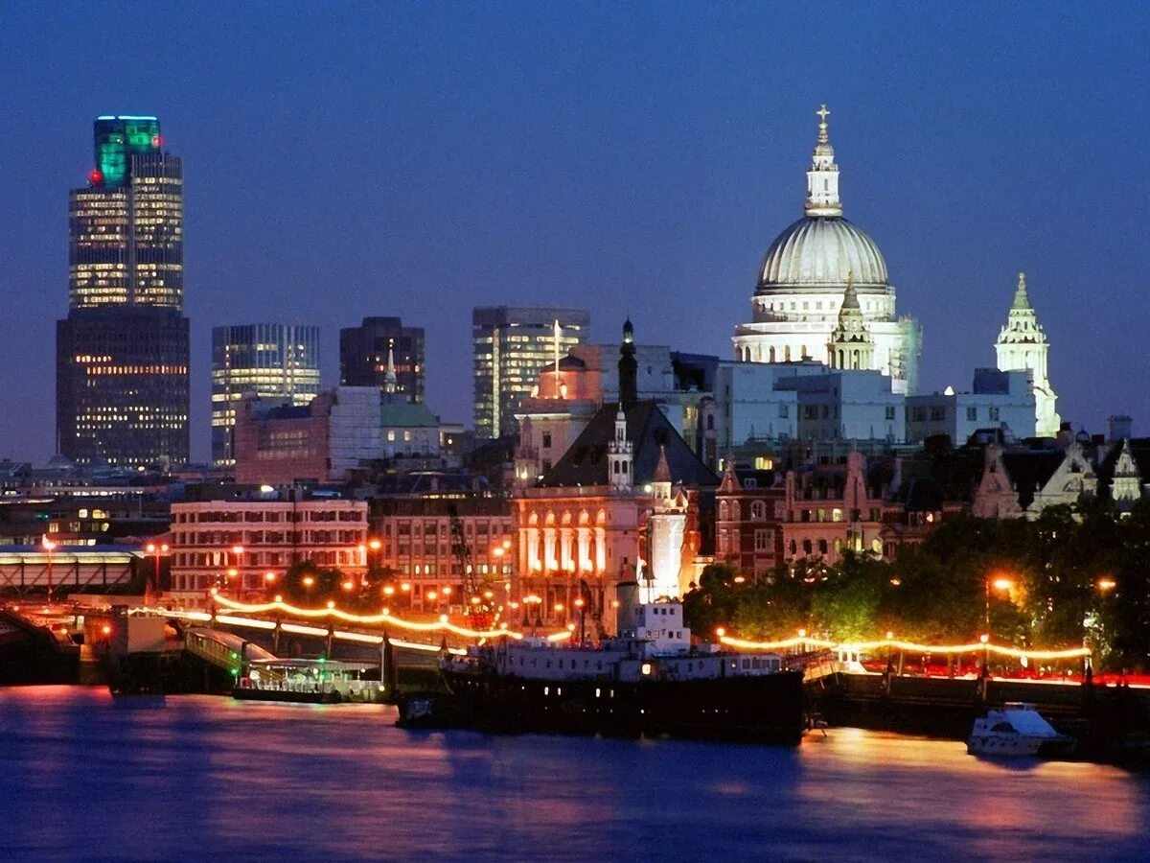
London's most famous places of interest

Slide 5
